Slide 1
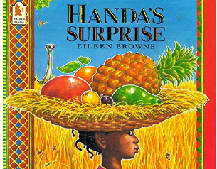
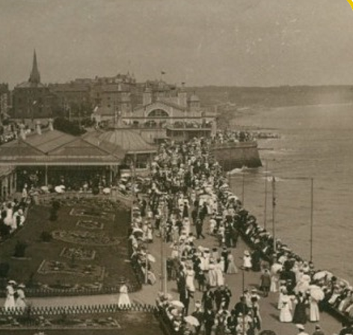
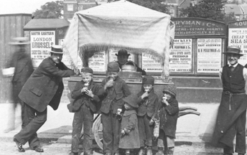
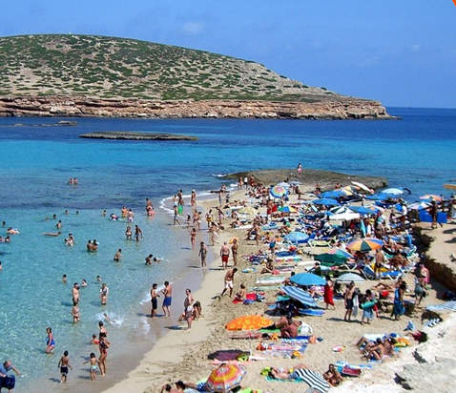
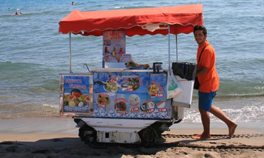
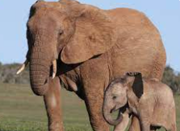
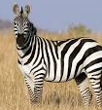
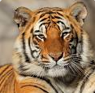
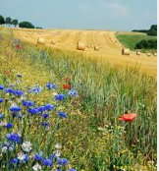
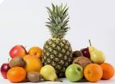
This half term we will be reading Handa’s Surprise by Eileen Browne. The children will be comparing life in Kenya to that in Great Britain.
We are going to find out what the seaside used to be like in the olden days and compare it to how it is now.
What is the same?
What is different?
We will be fruit tasting and the children will make their own fruit kebabs. The children will use fruit to print repeating patterns.
Oh I do like to be beside the seaside!
The children will research animals that come from African countries.
We will be looking for signs of summer. We will be looking at ways to stay safe in the sun and what clothes to wear.
Now we have covered all 4 seasons we will compare them.
Have you been to the Safari Park and seen these animals in real life?

Slide 2
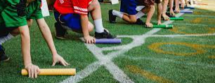
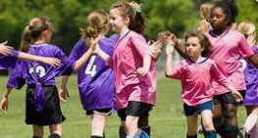
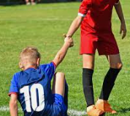
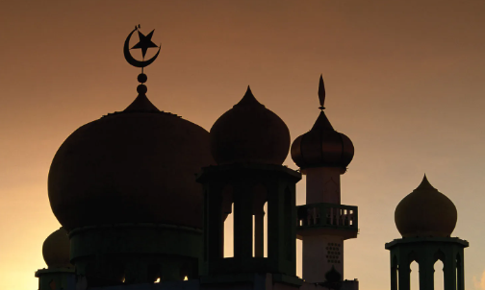
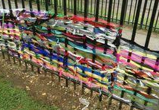
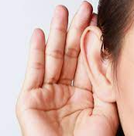
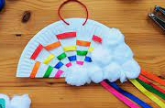
Key Vocabulary
Past | Something that has already happened
Present | Something that is happening right now
Future | Something that will happen in the future
Fiction | A made up story.
Non-fiction | Writing about real events and facts.
In PE we will be practising for our Sports Day and developing the children's understanding of playing games through the topic of 'transport'.
This unit will help the children understand what a team is and how to behave when we win and when we lose.
Sportsmanship
In PHSE the children will learning the importance of listening carefully, telling the truth and thinking of other’s feelings.
In art we will be looking at weaving. The children will start with large scale weaving with fabric on Brambles fence before moving to more intricate weaving using paper, ribbon and natural resources.
In RE we will be talking about the features of a mosque and the objects which can be found inside.
We will then start to compare how holy places are similar and how they are different.

