Slide 2
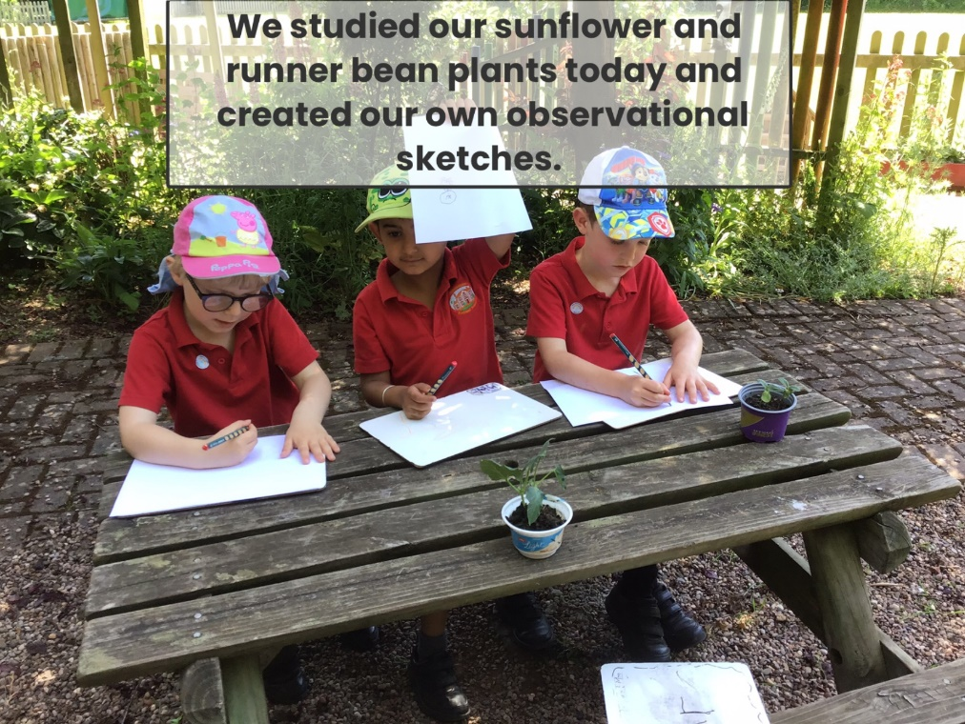
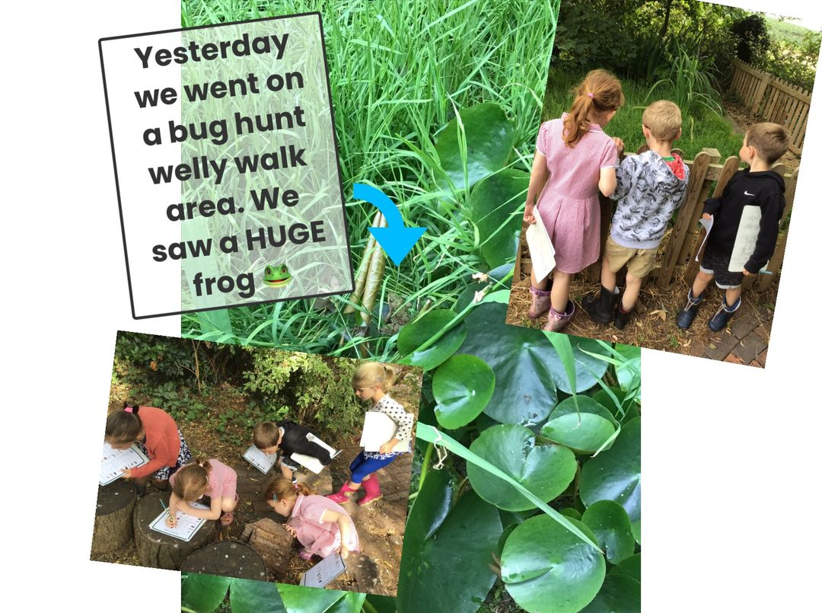
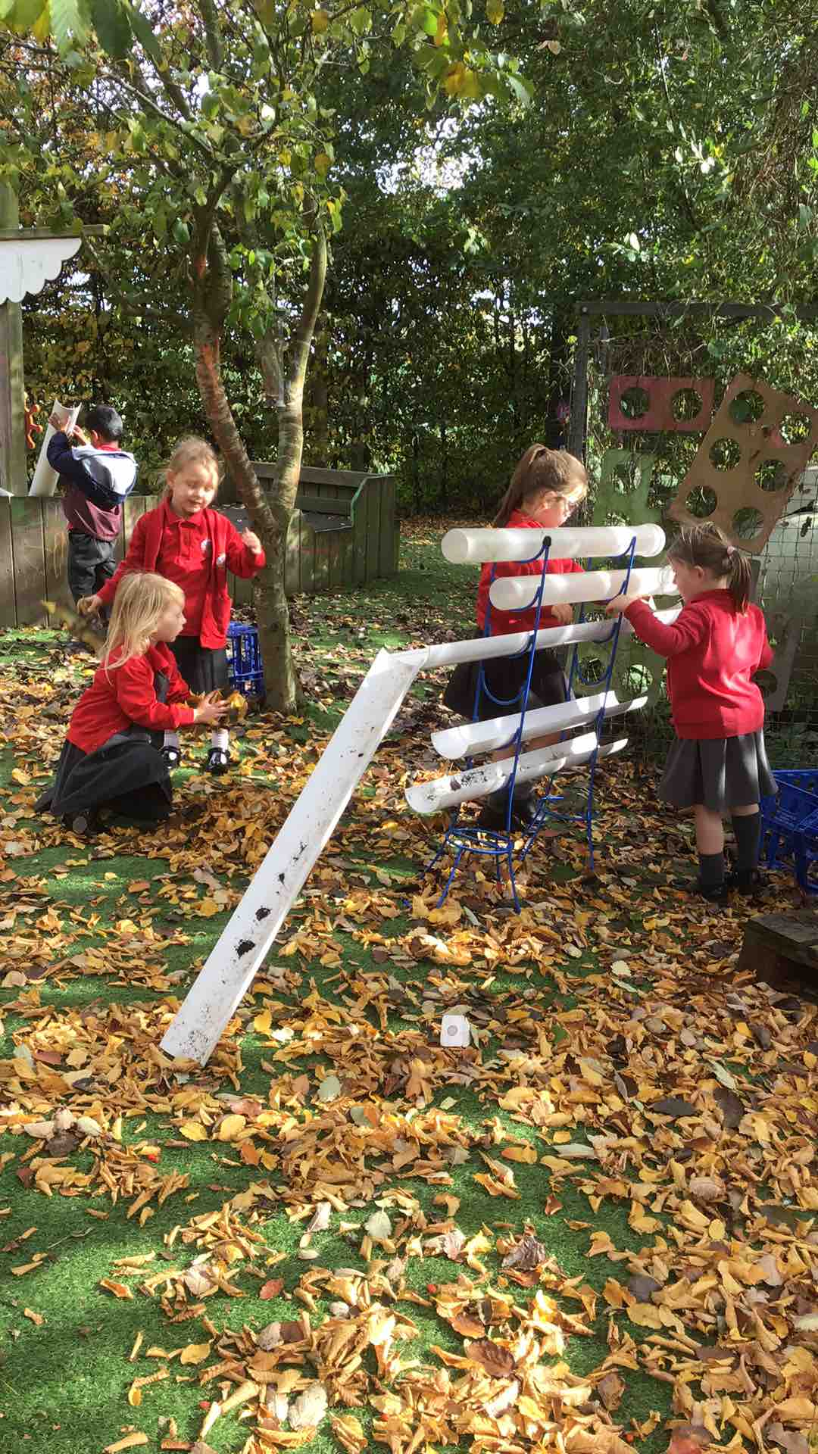
Welcome!

Slide 3
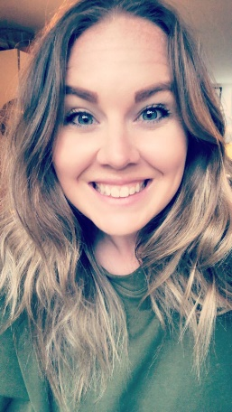
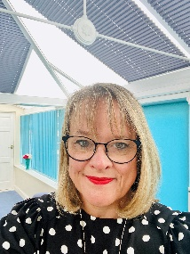
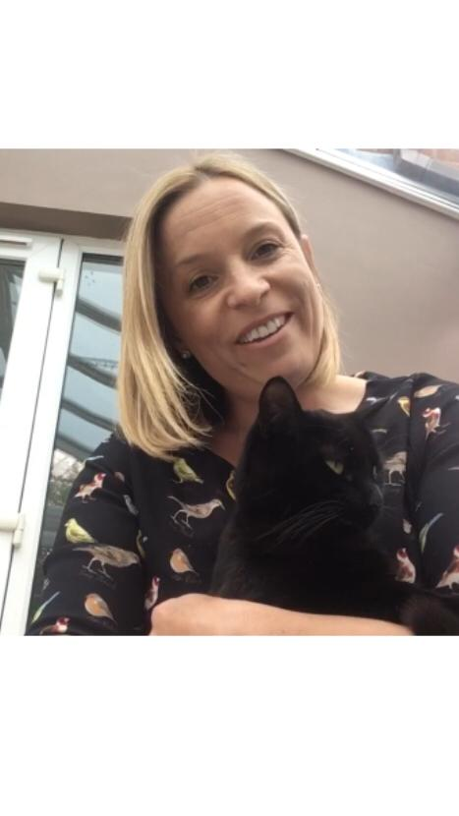
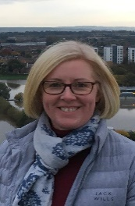
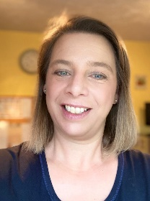
Our Staff
Miss Rebecca Gilmour
Current Early Years Leader/PE Lead
Mrs Natalie Hothi
Early Years Teaching Assistant/Wellbeing Lead
Mrs Amanda Richards
Headteacher
Mrs Jenny Bishop
School Business Manager
Mrs Jane Lawson
Office Assistant

Slide 4
A little bit about our school…
The first school run by the Lloyds Charity was created in 1729 and was a Dames School
30 children were taught by one lady from Brooms Cottage
The building we are in now was built in 1868 to assist with the overcrowding of Ombersley school and cost £73 to build
This is now a Grade 2 Listed Building
In 2017 the school converted from a First School to a Primary offering an education from 4 – 11 years old
The school draws from a wide catchment area, including Dunhampton, Comhampton, Doverdale, Uphampton and Acton
Many parents from outside our own catchment area choose to send their children to this school subject to the availability of places
The school has the advantage of a spacious environment with extensive grounds including a large playground and field, an adventure playground, creative castle area, an environmental area, a Lottery Funded quiet play area with peaceful story circle, artificial play turf for all year use, many growing plots, and a dedicated Forest School area
Parent quotes March 2022:
“Excellent communication. Wonderful nurturing atmosphere. Forward thinking. Creative and child centred.”
“I love how inclusive the school is and is supportive of not only the children but the whole family. I appreciate the effort that goes into supporting the children's wellbeing and how you constantly strive to improve things. The teachers feel like part of an extended family and I know we can always reach out for support.”
“You are doing a great job all round and sometimes in the toughest of situations. The teachers clearly care about pupils and really go the extra mile to make their time at school special. “

Slide 5
Our Vision
Ready, Steady, Grow!
Ready Ready to learn and ready for life
Steady Develop confidence and resilience
Grow Grow as a person socially, emotionally and academically, exceeding our own expectations

Slide 6
Our Values
Be Respectful
Be Kind
Be Honest
Be Determined
BELIEVE!

Slide 7
Our Track Record
The percentage of pupils achieving a Good Level of Development at the end of Early Years has been consistently well above that of other schools nationally prior to COVID
Over the past four years the proportion of pupils achieving Age Related Expectations or above has been consistently well above that of other schools nationally
The proportion of pupils achieving the Expected Standard in phonics at the end of Key Stage 1 has consistently been well above that of other schools nationally for the past five years (Year 1 2021 100%)
Achievement prior to COVID at the end of KS2 has generally been well above that of other schools nationally
OFSTED 2009 – Outstanding
High Quality Remote Learning Offer (Local Authority)

Slide 8
Parent Communication
Seesaw App/Teachers to Parents
Evidence Me
New School Website www.sytchampton.worcs.sch.uk
School Facebook Page, Twitter Account
School Money (Ordering Uniform, paying for dinners, trips, music lessons etc)

Slide 9
Wrap Around Care
We operate our own wrap around provision with Breakfast (8.00am to 8.50am) and After School Care (15.00 – 17.30) on site using the school buildings and facilities
Currently based in the Hall
Outside clubs and providers
Details about these will be sent out in your packs and these can be booked via the School Office

Slide 10
PTA (Parent Teacher Association)

Slide 11
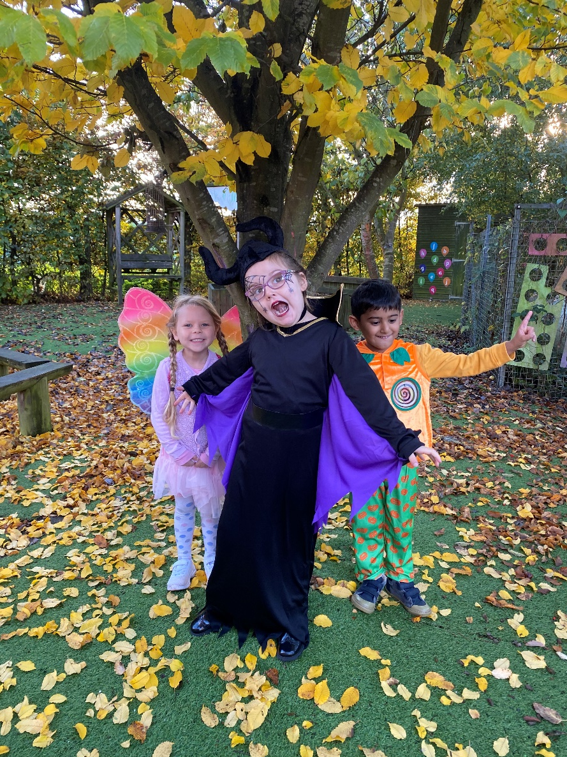
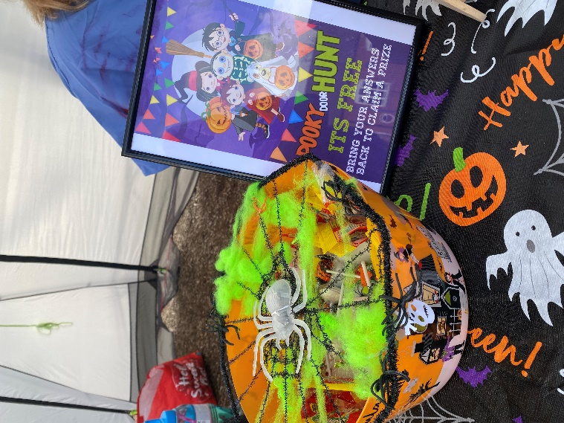
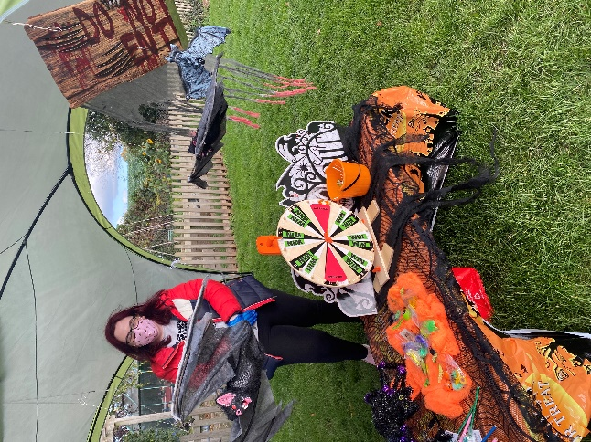
PTA (Parent Teacher Association)
New PTA Website and Facebook Page

Slide 12
How will we manage transition with a new teacher?
We have advertised the post of EYFS teacher over the past couple of weeks
Interviews are due to take place on Wednesday 6th July
We will continue to hold our planned transition mornings on Monday 20th June (09.00 – 10.00) and 14th July (10.30 – 11.30)
We are hoping that we will be able to invite our new teacher in for the morning on 14th July, and if not we will endeavour to arrange an alternative opportunity to do so prior to the end of the Summer Term
We will conduct our Home Visits in the Autumn Term

Slide 13
How will school look in September?
Monday 5th and Tuesday 6th September TED Days (School Closed to pupils)
Wednesday 7th to Friday 9th September – pupils will attend from 09.00 to 11.30 (Home visits will take place in the afternoons)
Monday 12th to Wednesday 14th September pupils attend from 09.00 to 12.45 (pupils are introduced to lunchtime routines and playtimes)
From Thursday 15th September, pupils will be in school full time

Slide 14
Parking
We have an agreement with the local Community Centre to use their car park
We ask parents to make a contribution of £15 a year towards this
Please be considerate and do not park across the driveways of houses

Slide 15
Safeguarding
Designated Safeguarding Lead – Amanda Richards
Deputy Safeguarding Leads – Laura Lawson, William Webster
We are committed to safeguarding and promoting the welfare of children and expect all staff and volunteers to share this commitment
We have a robust Safeguarding Policy in place (available from the School Office and on the School Wesbsite) and all staff (including students, volunteers and governors) must ensure that they are familiar with our safeguarding procedures
Sometimes we may need to share information and work in partnership with other agencies when there are concerns about a child’s welfare
We will ensure that concerns about pupils are discussed with parents/carers first – unless we have reason to believe that such a move would be contrary to the child’s welfare.

Slide 16
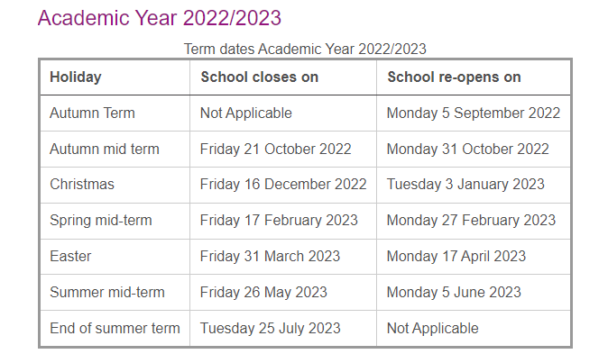
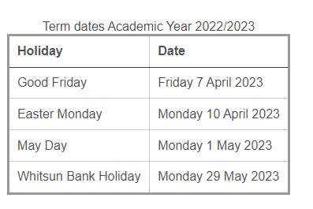
Term Dates
Monday 5th and Tuesday 6th September are TED Days (School is closed to pupils)
Summer Term Finishes 21st July 2023

Slide 17
Parent Questions
If you do have any other queries or questions, please contact the office on office@sytchampton.worcs.sch.uk

